Slide 1
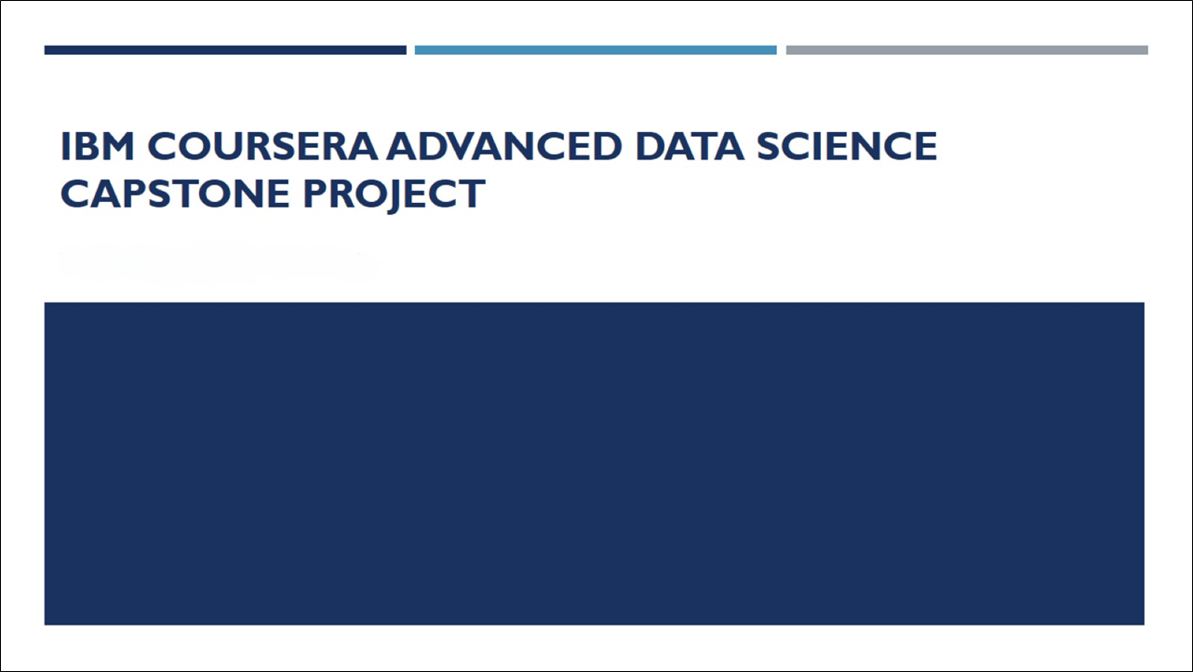
IBM Coursera Advanced Data Science Capstone Project
Radhika Aggarwal
||||||||||||||||||||||||||||

Slide 2
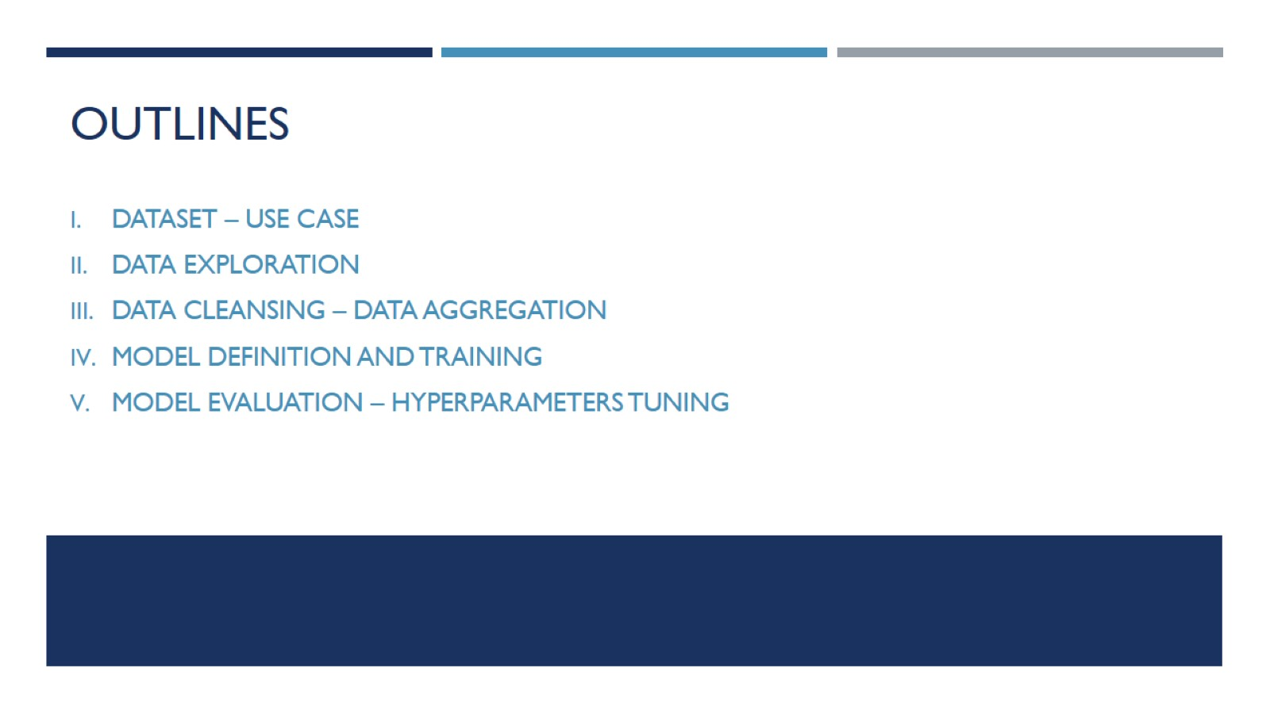
Outlines

Slide 3
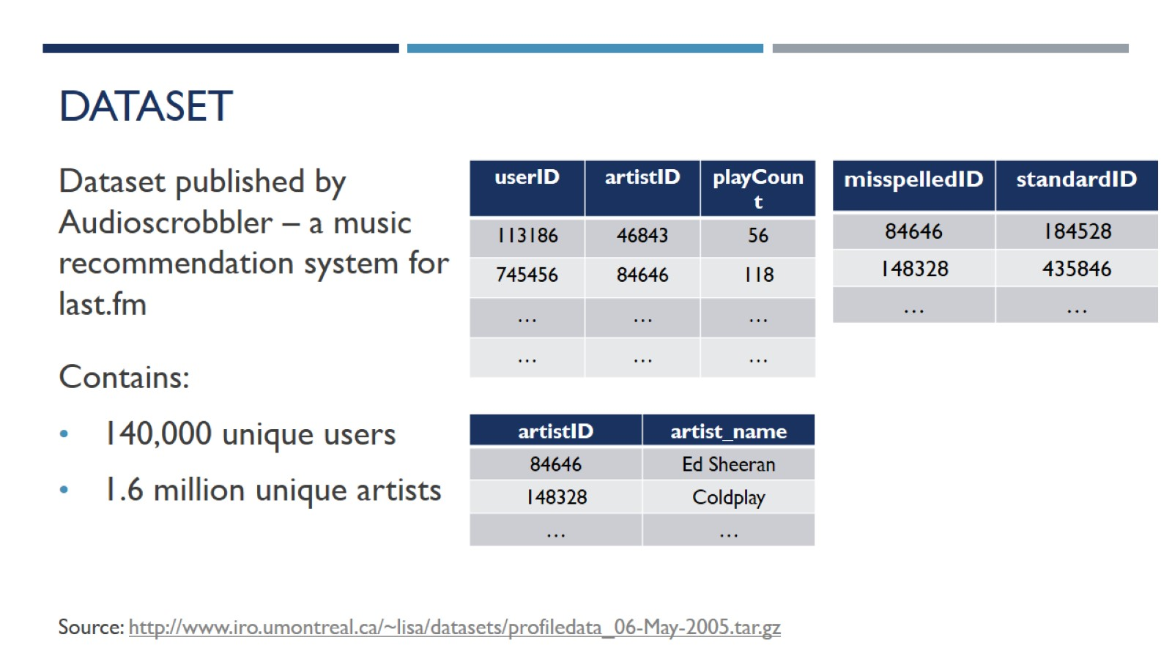
Dataset

Slide 4
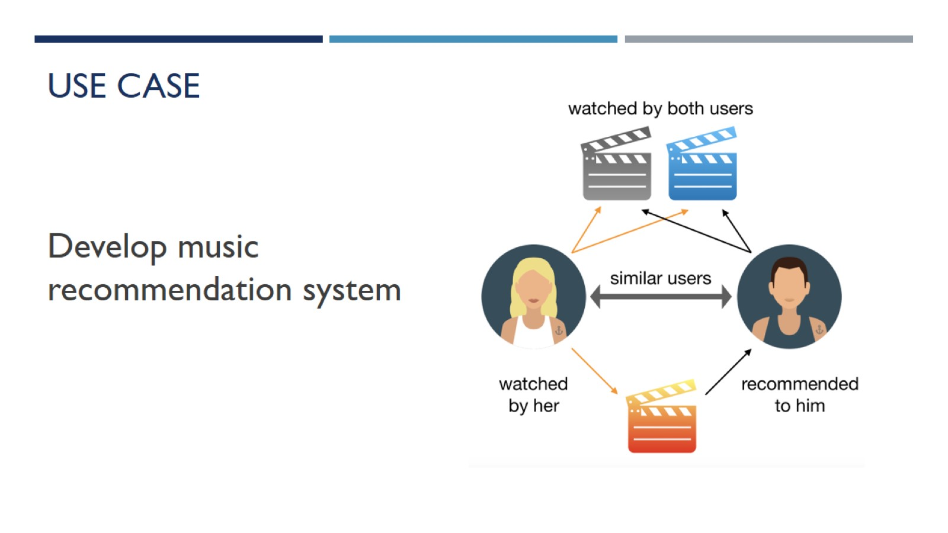
Use case

Slide 5
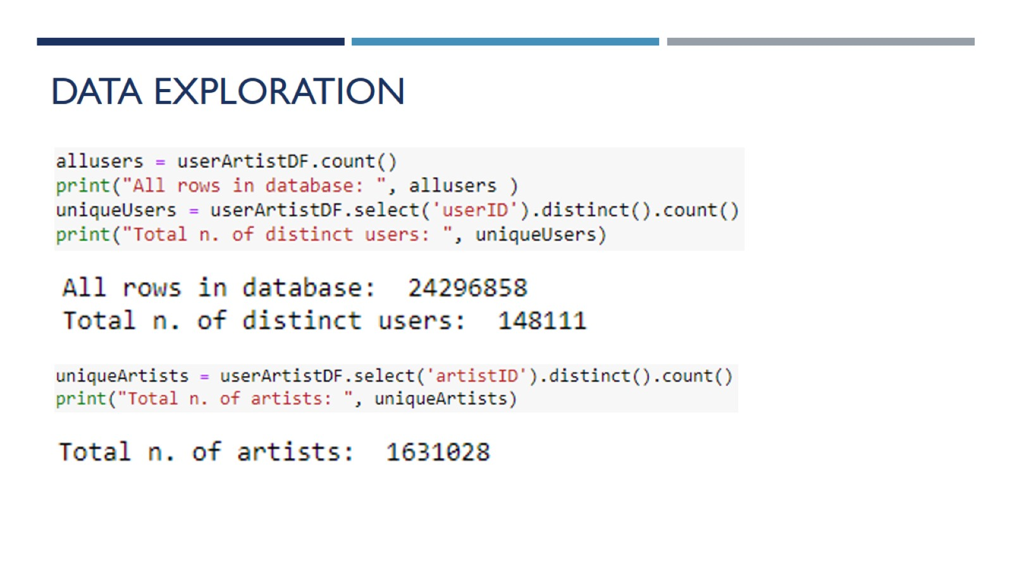
Data exploration

Slide 6
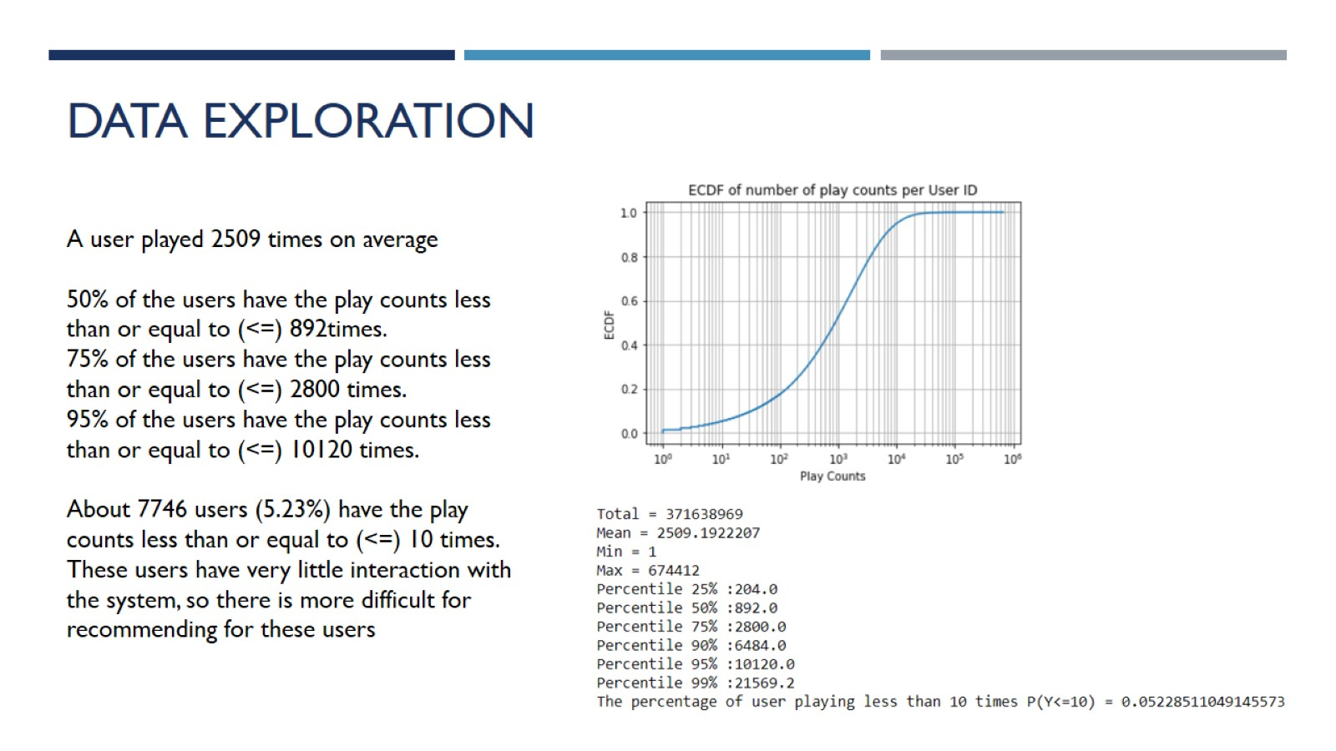
Data exploration

Slide 7
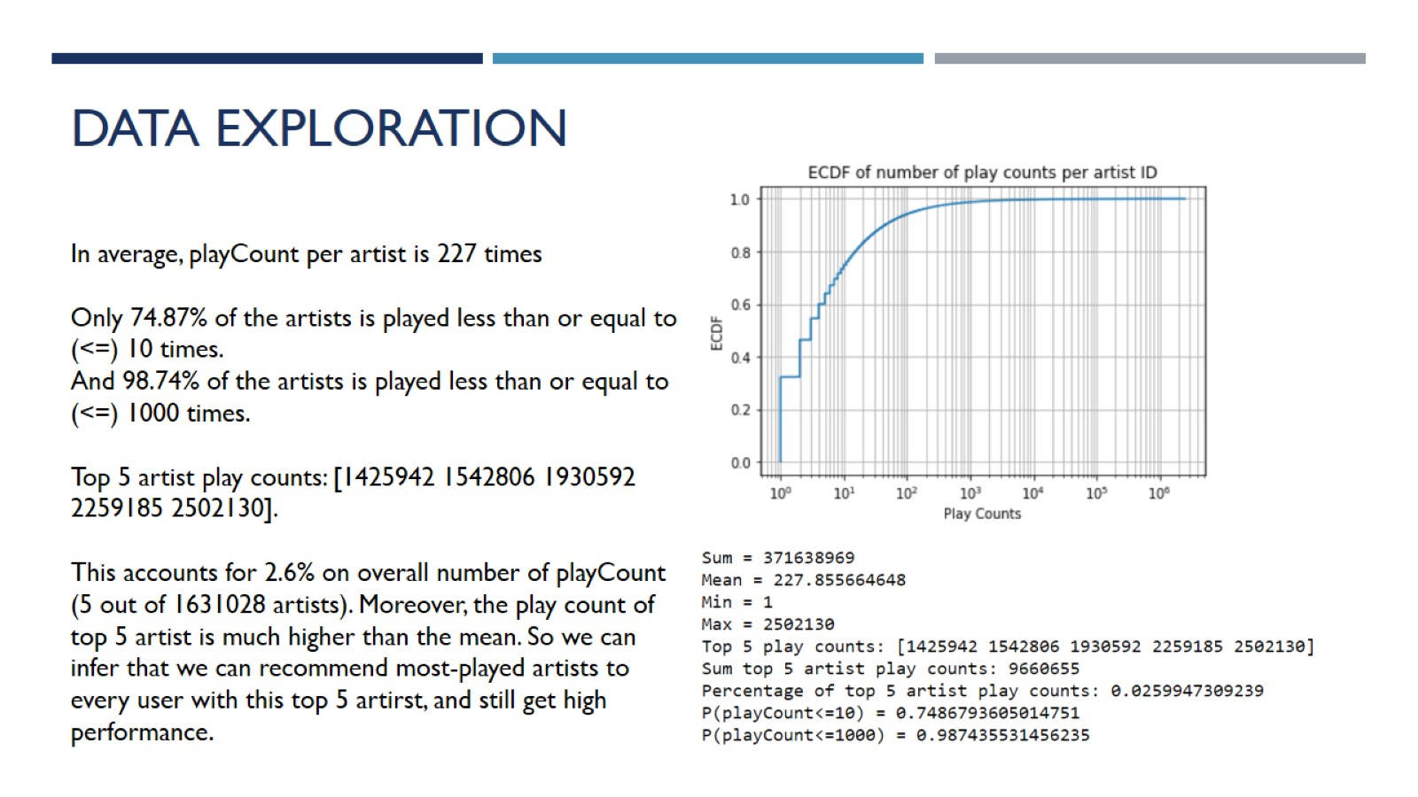
Data exploration

Slide 8
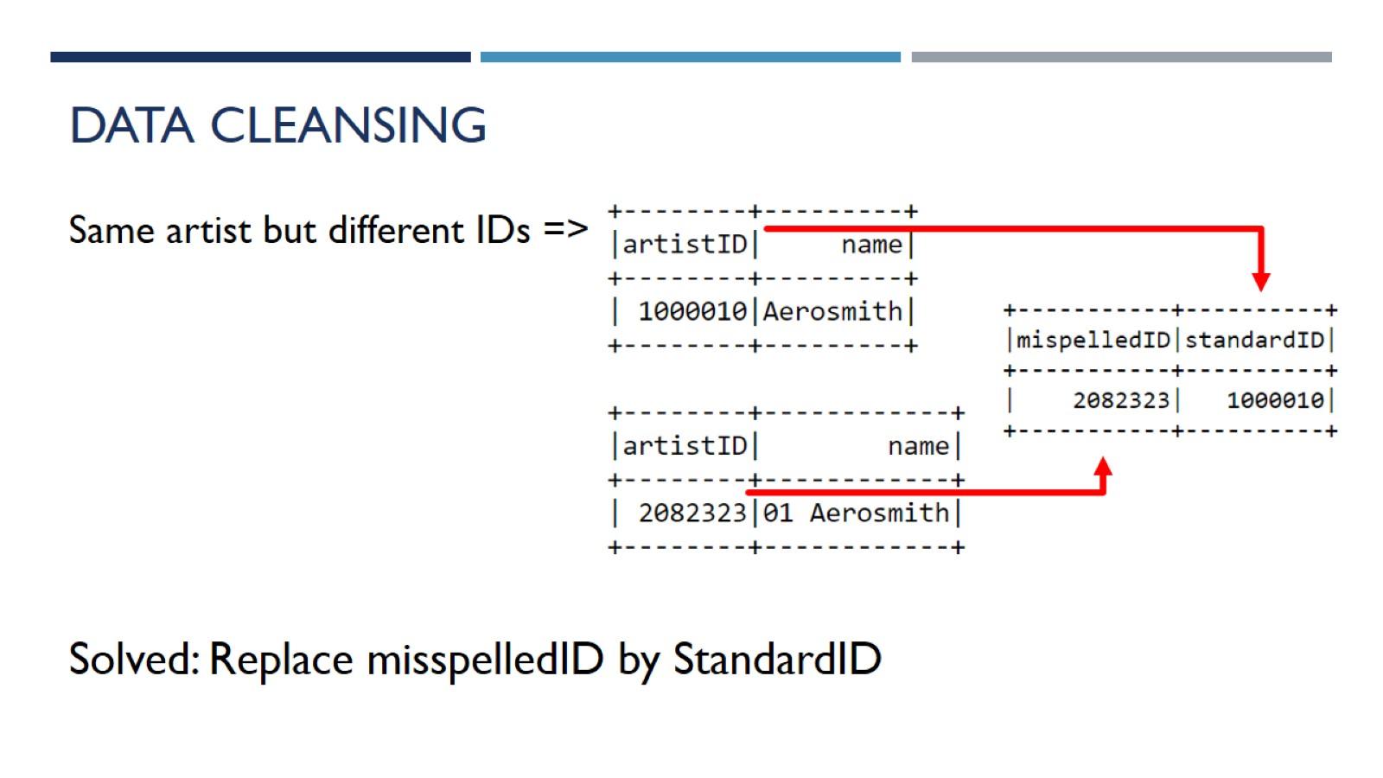
Data Cleansing

Slide 9
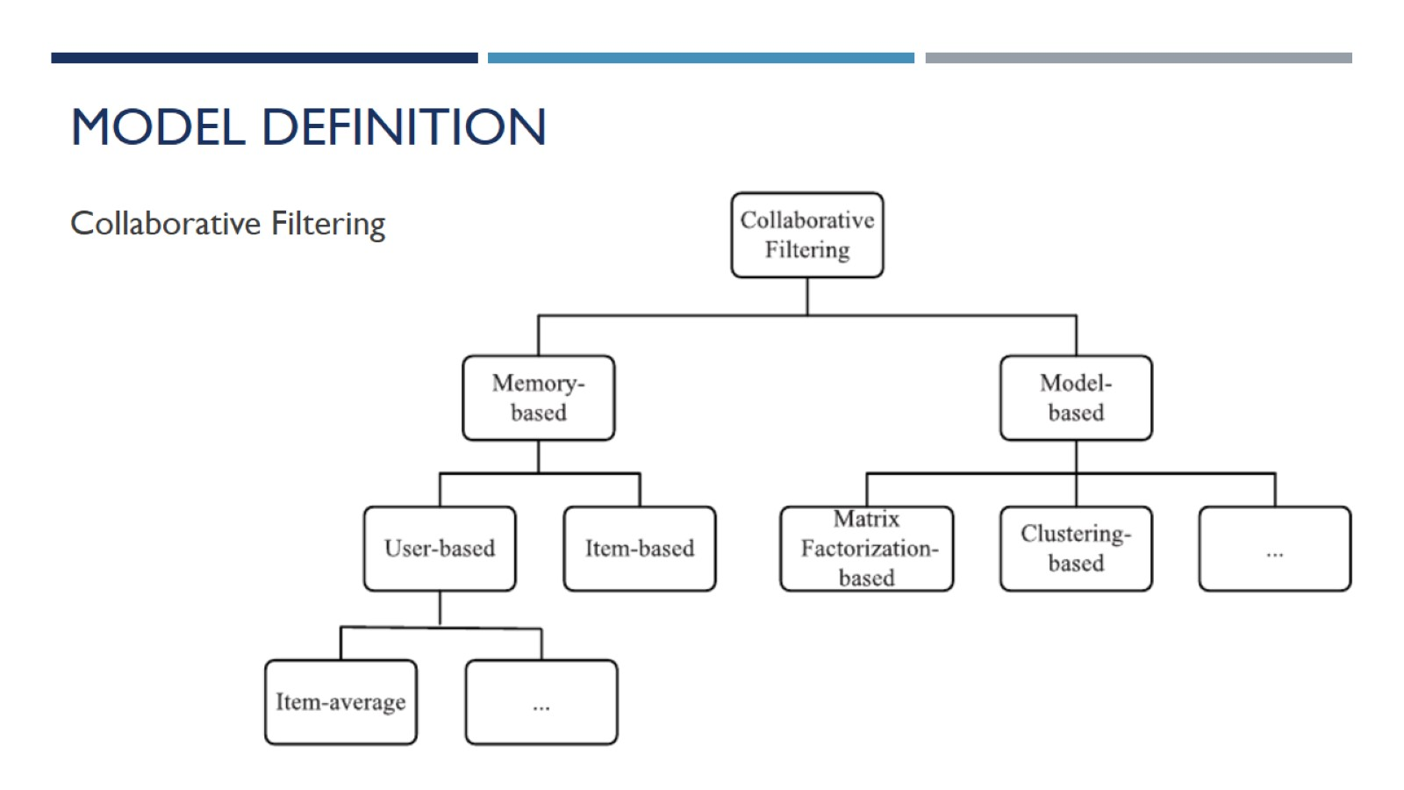
Model definition

Slide 10
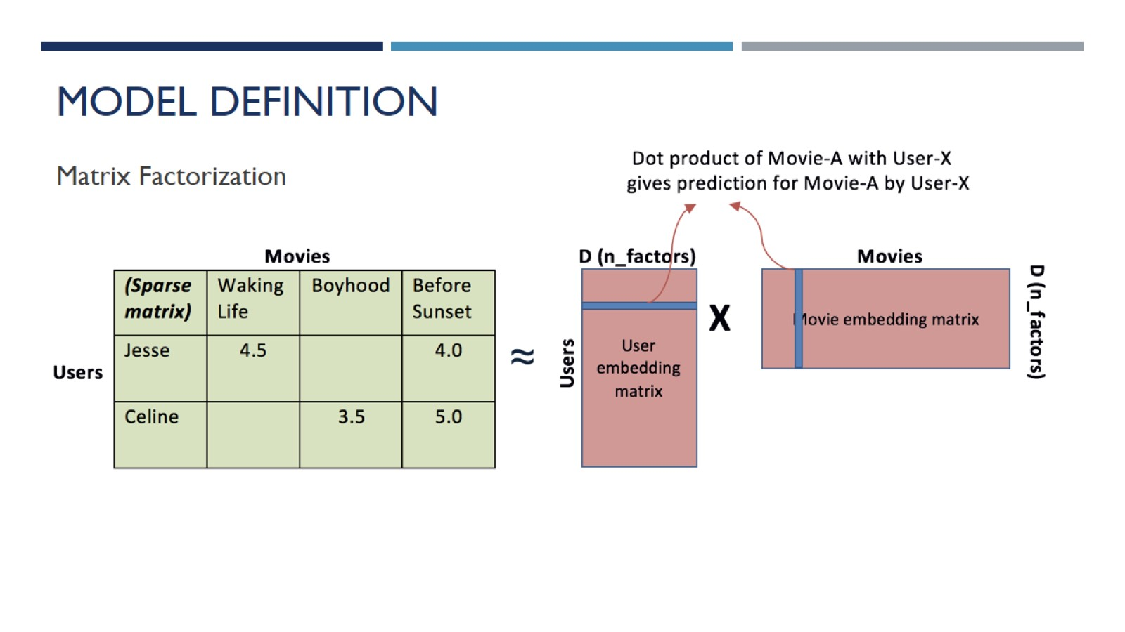
Model definition

Slide 11
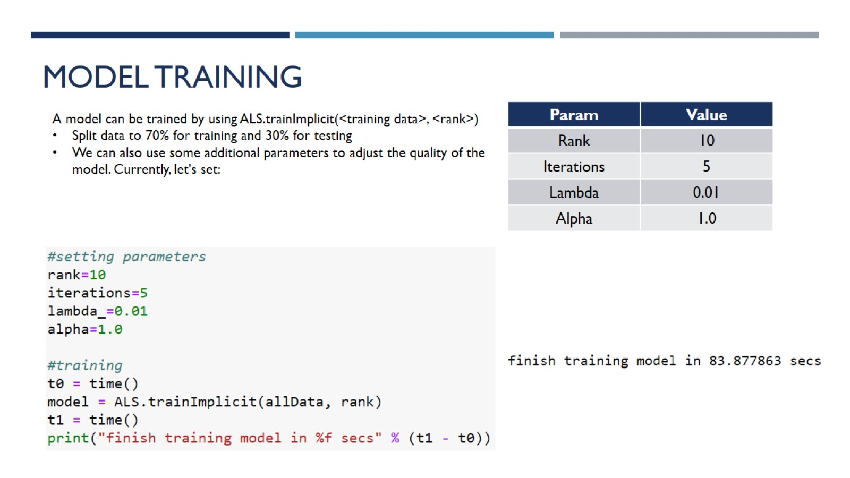
Model Training

Slide 12
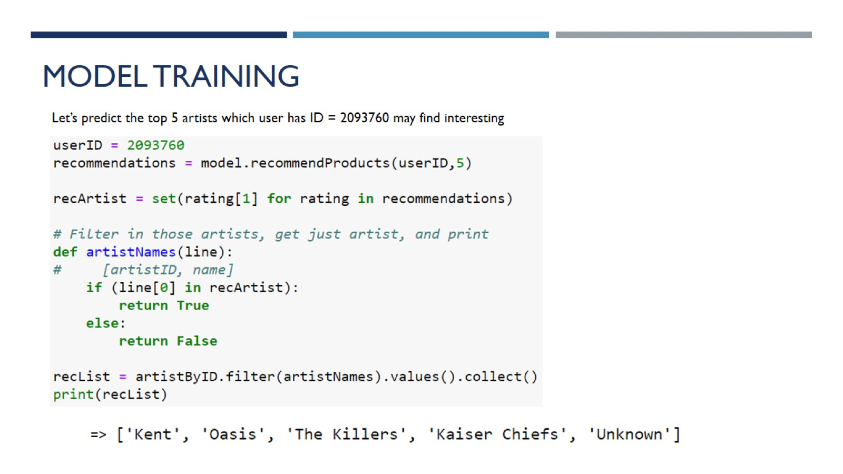
Model Training

Slide 13
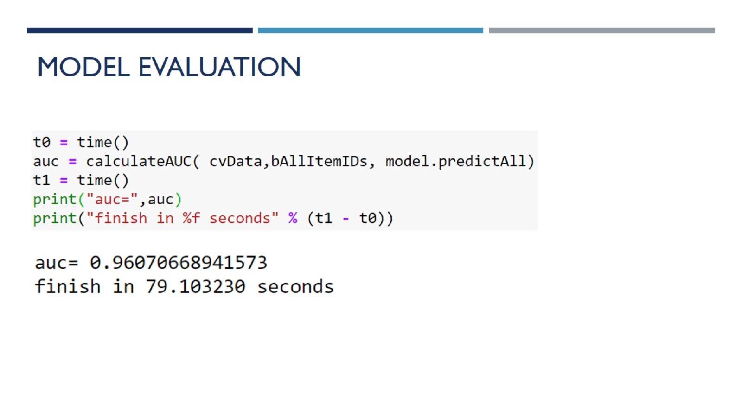
Model Evaluation

Slide 14
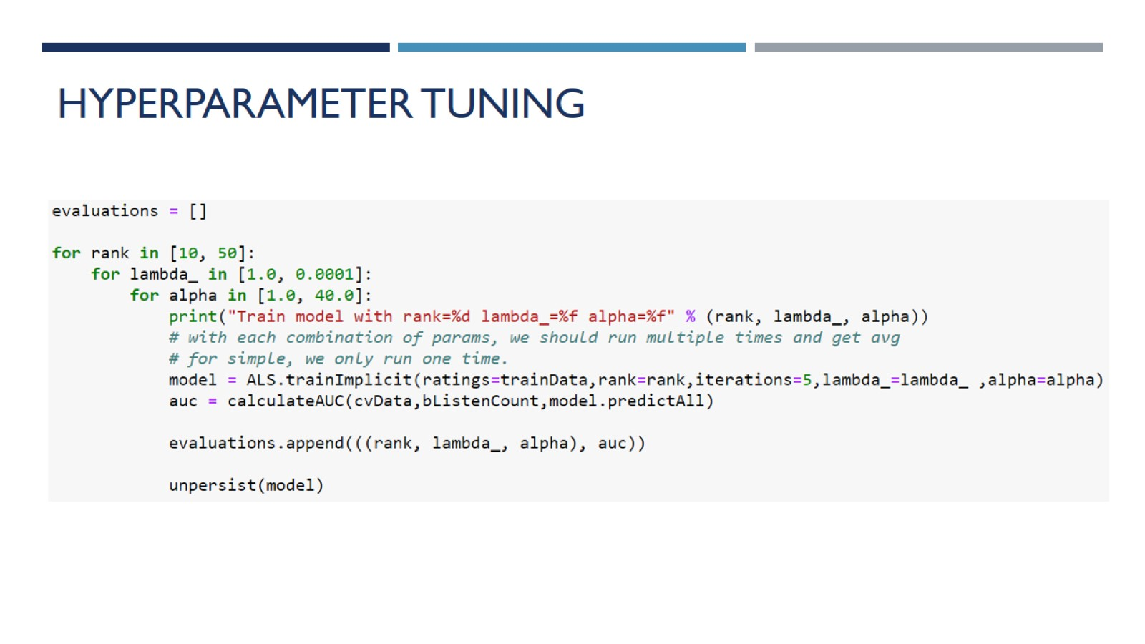
Hyperparameter tuning

Slide 15
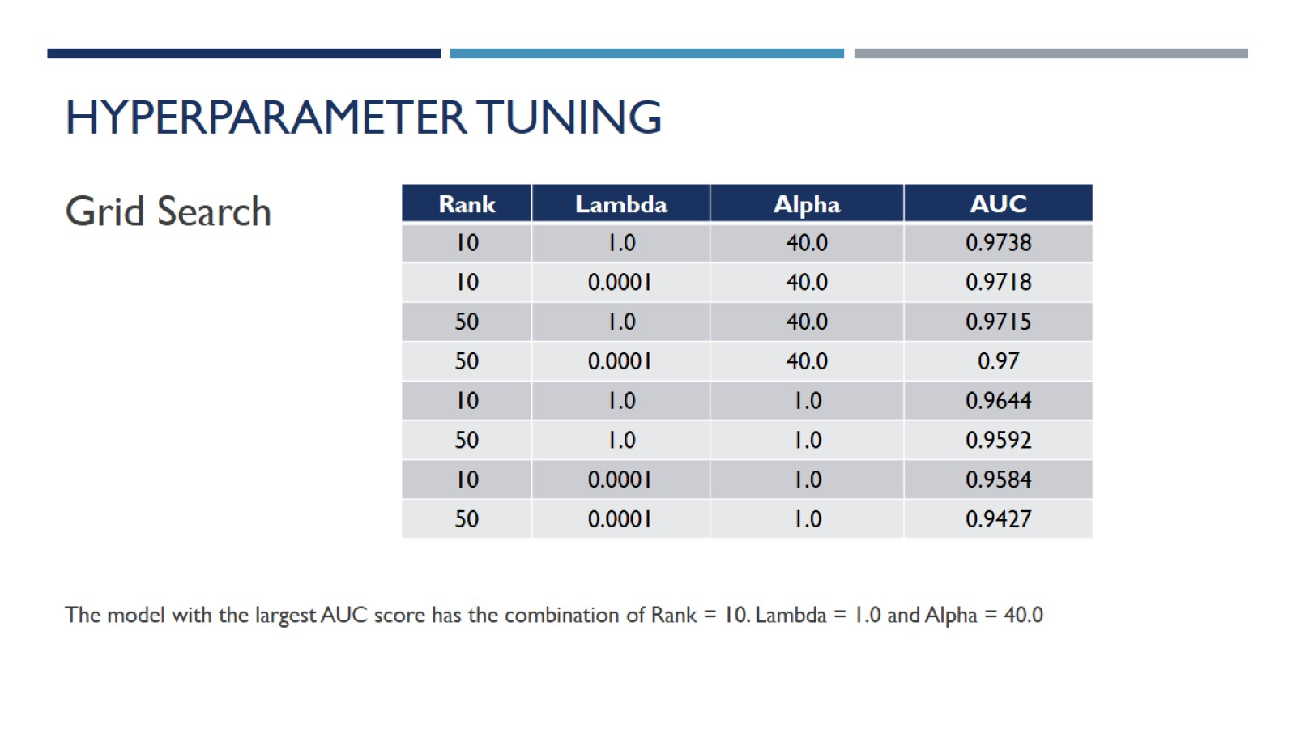
Hyperparameter tuning

Slide 16
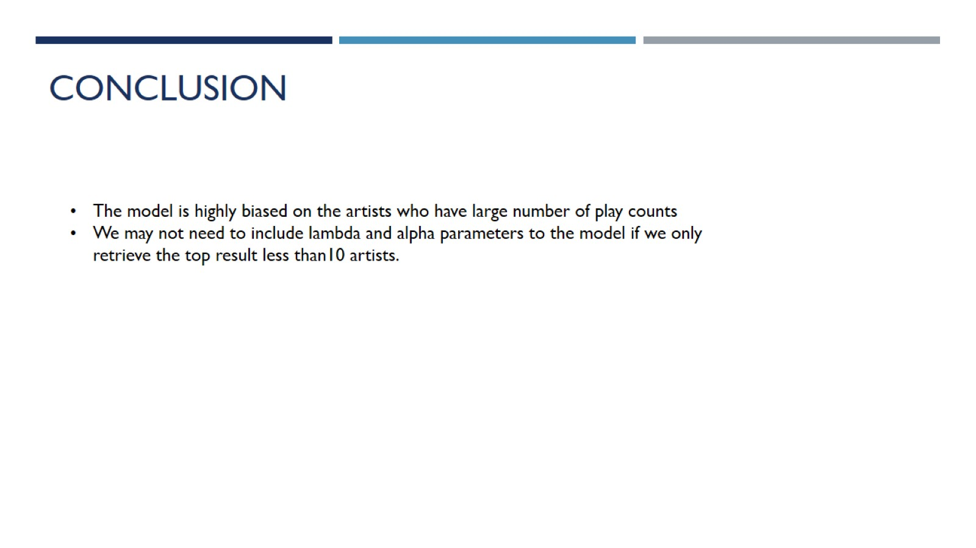
Conclusion

